Slide 1
WORLD OF LASERS
Laser Definition

Slide 2
?
WHAT IS A LASER?
It is a device that emits light through a process of optical amplification based on the stimulated emission of electromagnetic radiation.
x
x

Slide 3
WHY LASER?
?
L A S E R
Light Amplification by Stimulated Emission of Radiation

Slide 4
Electromagnetic radiation is a natural phenomenon found in almost all areas of daily life, from radio waves to sunlight to x-rays. Laser radiation – like all light – is also a form of electromagnetic radiation.
LIGHT
SPECTRUM

Slide 5
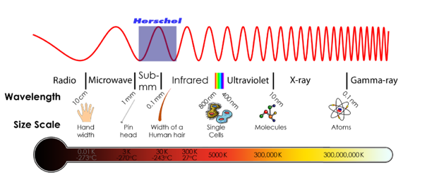
?
LIGHT SPECTRUM
Electromagnetic radiation that has a wavelength between 380nm and 780nm is visible to the human eyes and is commonly referred to as light.

Slide 6
?
LIGHT SPECTRUM
Infrared (IR) - longer than 780nm
Ultraviolet (UV) - shorter than 380nm
They are invisible to the human eyes.

Slide 7
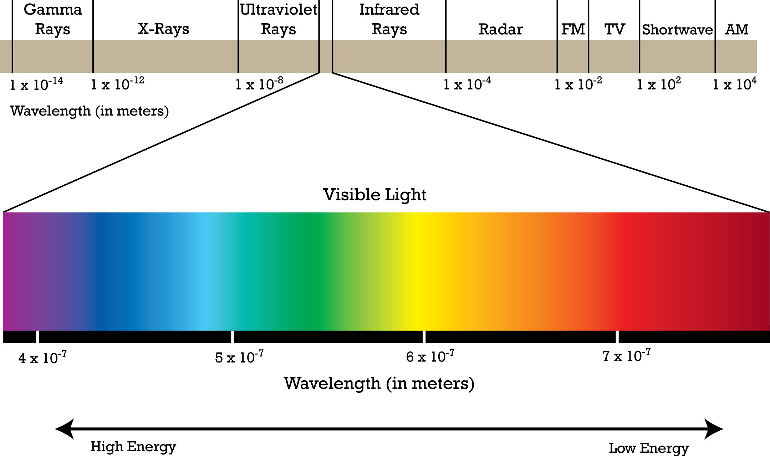
?
LIGHT SPECTRUM

Slide 8
?
WELL DONE!
Now you can move on to the next topic...
LASER INVENTION!

